Slide 1

VE496 Advanced Technical Communication
Week 3:
Abstracts and Executive Summaries
Nathaniel T. Murray 莫子禅
Summer 2020

Slide 2

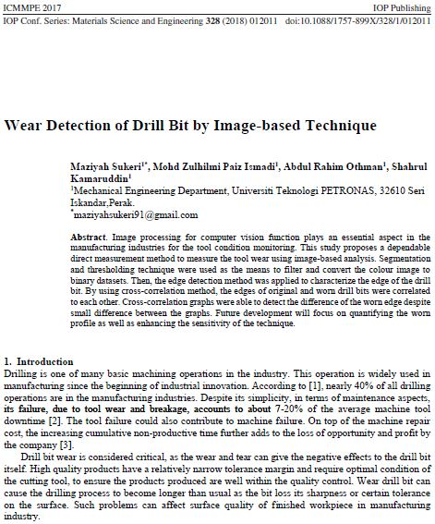
Abstracts
Journal article
Conference paper

Slide 3
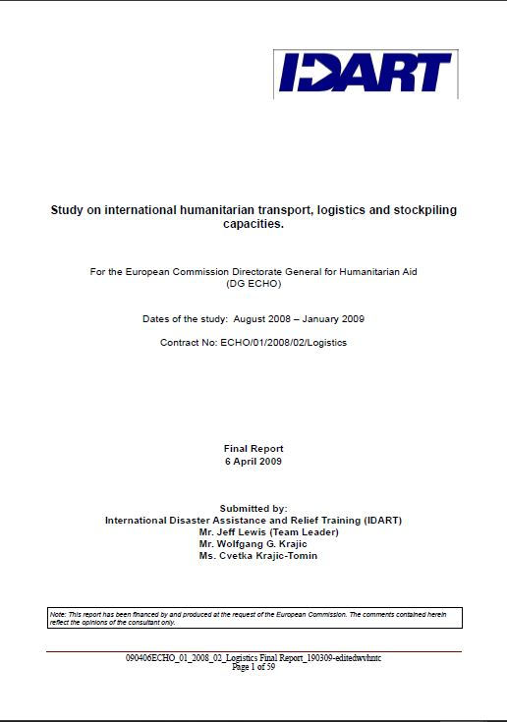
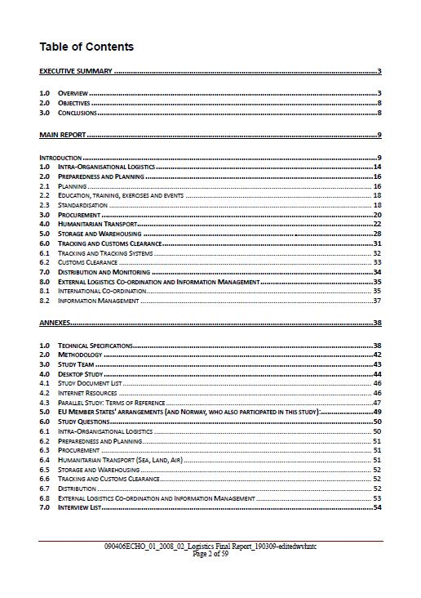
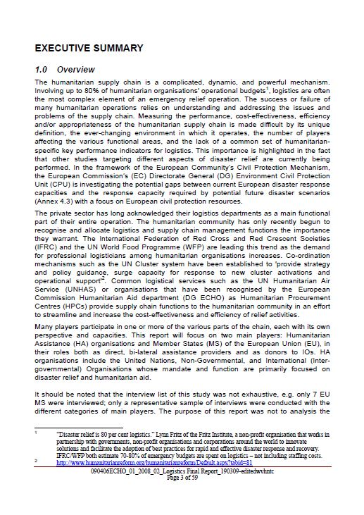
Executive Summaries
Consulting report

Slide 4
Abstract vs. Executive Summary
 | Abstract | Executive Summary
Length | 200-500 words | Full page
Commonly used in | Lab reports, journal articles, conference papers and posters | Project or consulting reports
Content | Topic, purpose, method, findings, recommendations (1-2 sentences each) | Brief summary of most of the key findings and/or recommendations of the report
Specialization | Technical language | Everyday language
Originality | Sentences may be copied from article | Sentences should be original or paraphrased
Intended for | Specialists in your topic, such as colleagues or peers in your field | Non-specialists such as department or division managers

Slide 5
Purpose of an Abstract/Executive Summary
Inform reader of key details contained in article/report
Help readers decide whether to read rest of the document
Provide a navigational tool for the whole document

Slide 6
Parts of an Abstract
General topic, research territory
Problem statement, knowledge gap
Purpose statement
Methods, methodology
Results, findings
Discussion, implications

Slide 7
Abstract Types
 | Descriptive | Informative
Content | Describes the types of information contained within the article, but does not directly discuss findings or implications | Describes the findings, implications, and conclusions themselves
Types of articles | Literature reviews, theoretical papers | Design reports, research articles
Key phrases | “Six themes were uncovered…” “Implications will be discussed…” | “Results indicate that…” “These findings suggest that…”

Slide 8
Example Abstract: Content
It is common practice for developers of user-facing software to transform a mock-up of a graphical user interface (GUI) into code. This process takes place both at an application’s inception and in an evolutionary context as GUI changes keep pace with evolving features. Unfortunately, this practice is challenging and time-consuming. In this paper, we present an approach that automates this process by enabling accurate prototyping of GUIs via three tasks: detection, classification, and assembly. First, logical components of a GUI are detected from a mock-up artifact using either computer vision techniques or mock-up metadata. Then, software repository mining, automated dynamic analysis, and deep convolutional neural networks are utilized to accurately classify GUI-components into domain-specific types (e.g., toggle-button). Finally, a data-driven, K-nearest-neighbors algorithm generates a suitable hierarchical GUI structure from which a prototype application can be automatically assembled. We implemented this approach for Android in a system called REDRAW. Our evaluation illustrates that REDRAW achieves an average GUI-component classification accuracy of 91% and assembles prototype applications that closely mirror target mock-ups in terms of visual affinity while exhibiting reasonable code structure. Interviews with industrial practitioners illustrate ReDraw’s potential to improve real development workflows.
Source: Moran et al. (2018)

Slide 9
Abstract Parts
General topic, research territory: Converting a mockup of a graphic user interface into actual code
Problem statement, knowledge gap: Time-consuming process
Purpose statement: Automate the process of converting GUI mockup into actual code
Methods, methodology: Detect logistical components, classify components into domain-specific types, generate hierarchical GUI structure
Results, findings: Prototype resembles mockup by 91%
Implications, recommendations: Potential to improve real development workflows

Slide 10
Abstract Aspects
Descriptive or Informative?
Research or Development?
Theoretical or Empirical?
Journal or Conference?

Slide 11
Signaling Words
Problem statement, knowledge gap | However… It is unclear… It is not yet known…
Results, findings | Here we show… Results show that… It was found that…
Conclusions, implications | Thus… Therefore… It is concluded that… We conclude that… Our results suggest…

Slide 12
Example Revisited: Signaling Words
It is common practice for developers of user-facing software to transform a mock-up of a graphical user interface (GUI) into code. This process takes place both at an application’s inception and in an evolutionary context as GUI changes keep pace with evolving features. Unfortunately, this practice is challenging and time-consuming. In this paper, we present an approach that automates this process by enabling accurate prototyping of GUIs via three tasks: detection, classification, and assembly. First, logical components of a GUI are detected from a mock-up artifact using either computer vision techniques or mock-up metadata. Then, software repository mining, automated dynamic analysis, and deep convolutional neural networks are utilized to accurately classify GUI-components into domain-specific types (e.g., toggle-button). Finally, a data-driven, K-nearest-neighbors algorithm generates a suitable hierarchical GUI structure from which a prototype application can be automatically assembled. We implemented this approach for Android in a system called REDRAW. Our evaluation illustrates that REDRAW achieves an average GUI-component classification accuracy of 91% and assembles prototype applications that closely mirror target mock-ups in terms of visual affinity while exhibiting reasonable code structure. Interviews with industrial practitioners illustrate ReDraw’s potential to improve real development workflows.
Source: Moran et al. (2018)

Slide 13
Example Abstract: Content
The field of artificial intelligence (AI) has shown an upward trend of growth in the 21st century (from 2000 to 2015). The evolution in AI has advanced the development of human society in our own time, with dramatic revolutions shaped by both theories and techniques. However, the multidisciplinary and fast-growing features make AI a field in which it is difficult to be well understood. In this paper, we study the evolution of AI at the beginning of the 21st century using publication metadata extracted from 9 top-tier journals and 12 top-tier conferences of this discipline. We find that the area is in the sustainable development and its impact continues to grow. From the perspective of reference behavior, the decrease in self-references indicates that the AI is becoming more and more open-minded. The influential papers/researchers/institutions we identified outline landmarks in the development of this field. Last but not least, we explore the inner structure in terms of topics' evolution over time. We have quantified the temporal trends at the topic level and discovered the inner connection among these topics. These findings provide deep insights into the current scientific innovations, as well as shedding light on funding policies.
Source: Liu et al. (2018)

Slide 14
Abstract Parts
General topic, research territory: AI changing every aspect of society
Problem statement, knowledge gap: Rapid change makes the field difficult to map out
Purpose statement: Trace evolution of AI field
Methods, methodology: Meta-analysis of journals and conference papers
Results, findings: Fewer self-references means literature is growing, primary trends will be discussed in article
Implications, recommendations: Potential to improve real development workflows

Slide 15
Abstract Aspects
Descriptive or Informative?
Research or Development?
Theoretical or Empirical?
Journal or Conference?

Slide 16
Example Revisited: Signaling Words
The field of artificial intelligence (AI) has shown an upward trend of growth in the 21st century (from 2000 to 2015). The evolution in AI has advanced the development of human society in our own time, with dramatic revolutions shaped by both theories and techniques. However, the multidisciplinary and fast-growing features make AI a field in which it is difficult to be well understood. In this paper, we study the evolution of AI at the beginning of the 21st century using publication metadata extracted from 9 top-tier journals and 12 top-tier conferences of this discipline. We find that the area is in the sustainable development and its impact continues to grow. From the perspective of reference behavior, the decrease in self-references indicates that the AI is becoming more and more open-minded. The influential papers/researchers/institutions we identified outline landmarks in the development of this field. Last but not least, we explore the inner structure in terms of topics' evolution over time. We have quantified the temporal trends at the topic level and discovered the inner connection among these topics. These findings provide deep insights into the current scientific innovations, as well as shedding light on funding policies.
Source: Liu et al. (2018)

Slide 17
Example Abstract: Content
The outbreak of the 2019 Novel Coronavirus (2019-nCoV) has rapidly spread from Wuhan, China to multiple countries, causing staggering number of infections and deaths. A systematic profiling of the immune vulnerability landscape of 2019-nCoV is lacking, which can bring critical insights into the immune clearance mechanism, peptide vaccine development, and antiviral antibody development. In this study, we predicted the potential of all the 2019-nCoV viral proteins to induce class I and II MHC (major histocompatibility complex) presentation and form linear antibody epitopes. We showed that the enrichment for T cell and B cell epitopes is not uniform on the viral genome, with several focused regions that generate abundant epitopes and may be more targetable. We showed that genetic variations in 2019-nCoV, though fewer for the moment, already follow the pattern of mutations in related coronaviruses, and could alter the immune vulnerability landscape of this virus, which should be considered in the development of therapies. We create an online database to broadly share our research outcome. Overall, we present an immunological resource for 2019-nCoV that could significantly promote both therapeutic development and mechanistic research.
Source: Zhou et al. (2020)

Slide 18
Abstract Parts
General topic, research territory: Spread of coronavirus across the world
Problem statement, knowledge gap: No systematic profiling of nCoV-2019 vulnerabilities
Purpose statement: Predict nCoV-2019 viral proteins to identify weaknesses
Methods, methodology:
Results, findings: Genetic variations of nCoV-2019 are similar to other coronaviruses, making it easier to predict their evolution
Implications and recommendations: Enhance sensitivity of technique, quantify work profile

Slide 19
Abstract Aspects
Descriptive or Informative?
Research or Development?
Theoretical or Empirical?
Journal or Conference?

Slide 20
Example Abstract Revisited: Signaling Words
The outbreak of the 2019 Novel Coronavirus (2019-nCoV) has rapidly spread from Wuhan, China to multiple countries, causing staggering number of infections and deaths. A systematic profiling of the immune vulnerability landscape of 2019-nCoV is lacking, which can bring critical insights into the immune clearance mechanism, peptide vaccine development, and antiviral antibody development. In this study, we predicted the potential of all the 2019-nCoV viral proteins to induce class I and II MHC (major histocompatibility complex) presentation and form linear antibody epitopes. We showed that the enrichment for T cell and B cell epitopes is not uniform on the viral genome, with several focused regions that generate abundant epitopes and may be more targetable. We showed that genetic variations in 2019-nCoV, though fewer for the moment, already follow the pattern of mutations in related coronaviruses, and could alter the immune vulnerability landscape of this virus, which should be considered in the development of therapies. We create an online database to broadly share our research outcome. Overall, we present an immunological resource for 2019-nCoV that could significantly promote both therapeutic development and mechanistic research.
Source: Zhou et al. (2020)

Slide 21
Challenges of Writing a Good Abstract
Cutting words to within limit specified by requirements of journal or call for conference proposals
Deciding what information to include or exclude
Summarizing main points without being too verbose
Linking sentences together into cohesive paragraph
Signaling words are key here

Slide 22
Common Mistakes
Too many extraneous details
No clear purpose or conclusions
Contents are vague and imprecise
Descriptive when it should be informative, or vice-versa
Unfamiliar abbreviations without first spelling out them in full
Providing information not included in the main document
Lack of signaling words make cohesion weak

Slide 23
Keywords
Used by readers to search for relevant articles online
Specific, appropriate keywords increase the chances of your report or article being found (and, once found, actually read)
Should include a mix of general and specific items

Slide 24
Abstract #1 Revisited: Keywords
It is common practice for developers of user-facing software to transform a mock-up of a graphical user interface (GUI) into code. This process takes place both at an application’s inception and in an evolutionary context as GUI changes keep pace with evolving features. Unfortunately, this practice is challenging and time-consuming. In this paper, we present an approach that automates this process by enabling accurate prototyping of GUIs via three tasks: detection, classification, and assembly. First, logical components of a GUI are detected from a mock-up artifact using either computer vision techniques or mock-up metadata. Then, software repository mining, automated dynamic analysis, and deep convolutional neural networks are utilized to accurately classify GUI-components into domain-specific types (e.g., toggle-button). Finally, a data-driven, K-nearest-neighbors algorithm generates a suitable hierarchical GUI structure from which a prototype application can be automatically assembled. We implemented this approach for Android in a system called REDRAW. Our evaluation illustrates that REDRAW achieves an average GUI-component classification accuracy of 91% and assembles prototype applications that closely mirror target mock-ups in terms of visual affinity while exhibiting reasonable code structure. Interviews with industrial practitioners illustrate ReDraw’s potential to improve real development workflows.
Keywords: GUI, CNN, mobile, prototyping, machine learning, mining software repositories
Source: Moran et al. (2018)

Slide 25
Abstract #2 Revisited: Keywords
The field of artificial intelligence (AI) has shown an upward trend of growth in the 21st century (from 2000 to 2015). The evolution in AI has advanced the development of human society in our own time, with dramatic revolutions shaped by both theories and techniques. However, the multidisciplinary and fast-growing features make AI a field in which it is difficult to be well understood. In this paper, we study the evolution of AI at the beginning of the 21st century using publication metadata extracted from 9 top-tier journals and 12 top-tier conferences of this discipline. We find that the area is in the sustainable development and its impact continues to grow. From the perspective of reference behavior, the decrease in self-references indicates that the AI is becoming more and more open-minded. The influential papers/researchers/institutions we identified outline landmarks in the development of this field. Last but not least, we explore the inner structure in terms of topics' evolution over time. We have quantified the temporal trends at the topic level and discovered the inner connection among these topics. These findings provide deep insights into the current scientific innovations, as well as shedding light on funding policies.
Keywords: Artificial intelligence, data analytics, scientific impact, science of science, data science
Source: Liu et al. (2018)

Slide 26
Keyword Exercise
The current Internet is an end-to-end communication architecture based on packet switching between terminals. However, with the development of computer networks and increasing proliferation of communication services, the ability of this architecture-based Internet to transmit and process data has encountered challenges, and it has been unable to adapt to the rapid development of today’s application requirements. Thus, information-centric networking (ICN) is emerging as a feasible solution and has become a new hot topic for future research in network architecture. The ICN strips content from terminal locations and provides services such as storage and multi-party communication through the publish/subscribe paradigm. Although the ICN brings new opportunities for network development, there are plenty of problems existing in the ICN that have not been settled. For example, the conflict between polymerizability and mobility in the naming scheme, scalability problems of the name routing, as well as the inefficiency of transmission control algorithms under the circumstance of rich interest are all worth discussing. However, utilizing the computational and analytical features of artificial intelligence (AI) can help the ICN break through the bottleneck of existing technology development. With regard to the issues above, this article introduces and investigates some related technologies of AI in the ICN, that is, naming mechanism, transmission control, and content distribution, and introduces and surveys problems in ICN research. Furthermore, the next development direction of ICN and issues that need to be studied are discussed in this work.
Source: Yao et al. (2019)

